Slide 1
Operating System
Tim Pengampu MK Sistem Operasi
Universitas Dian Nuswantoro

Slide 2
Computer History
History of Development
1st Generation (1945 – 1955)
Vacuum Tubes
2nd Generation (1955 – 1965)
Transistors and Batch Systems
3rd Generation (1965 – 1980)
IC’s and Multiprogramming
4th Generation (1980 – Present)
Personal Computer

Slide 3
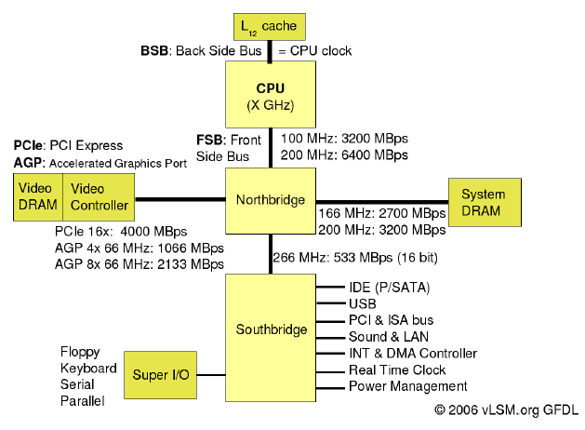
Computer Systems Diagram (HW)
Personal Computer (PC) Diagram

Slide 4
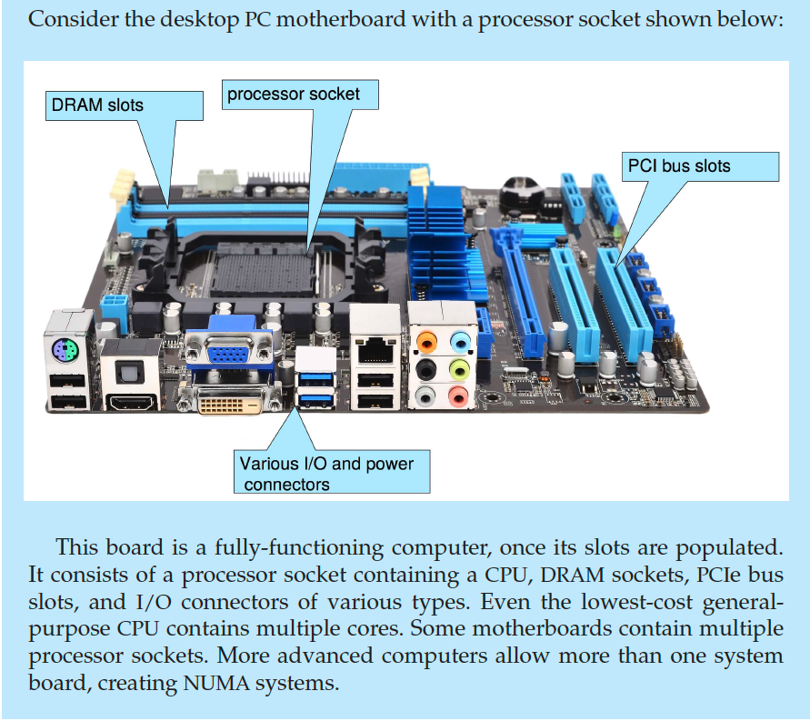

Slide 5
Hardware Basics
OS and hardware closely tied together
Many useful hardware features have been invented to compliment the OS
Basic hardware resources
CPU
Memory
Disk
I/O

Slide 6
CPU
CPU controls everything in the system
if work needs to be done, CPU gets involved
Most precious resource
this is what your paying for
want to get high utilization (from useful work)
Only one process on a CPU at a time
Hundreds of millions of instructions / sec
and getting faster all the time

Slide 7
Memory
Limited in capacity
never enough memory
Temporary (volatile) storage
Electronic storage
fast, random access
Any program to run on the CPU must be in memory

Slide 8
Disk
Virtually infinite capacity
Permanent storage
Orders of magnitude slower than memory
mechanical device
millions of CPU instructions can execute in the time it takes to access a single piece of data on disk
All data is accessed in blocks
usually 512 bytes

Slide 9
I/O
Disk is actually part of the I/O subsystem
they are of special interest to the OS
Many other I/O devices
printers, monitor, keyboard, etc.
Most I/O devices are painfully slow
Need to find ways to hide I/O latency
like multiprogramming

Slide 10
Computer Systems Block Scheme
Input Devices
Data Bus
Chipset
Cache
I/O Ports
Processor
Main Memory
Secondary
Bus
Control
Bus
Control
Output Devices
Address Bus

Slide 11

Any Question ?
Anything to discuss ?

Slide 12
Operating System Definition
It is hard to pin down what an operating system is other than saying it is the software that runs in kernel mode-and even that is not always true.
The main aspect that these operating system handle are :
Intermediary between hardware and user, and
as a system resources manager

Slide 14
Operating System Diagram
user
1
user
2
. . .
user
n
compiler
text editor
ls
system and application programs
operating system
hardware

Slide 15
Operating System Block Scheme
Processor
Interpreater
K E R N E L
Input
Brain Ware
Main Memory
File System
Output
Secondary Memory

Slide 16
Operating System
Where it fits ?

Slide 17
Operating System
OS Re-Presentation

Slide 18
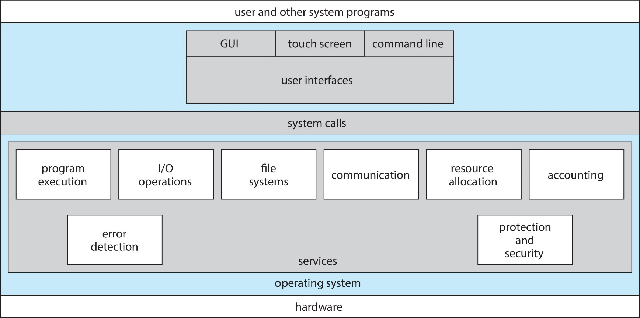
A View of Operating System Services

Slide 20
Operating System
Level and Point of View
Users
Applications
Programmer
Utilities
Operating System
OS Designer
Computer Hardware

Slide 21
Operating System Goals
Users expect certain properties of operating systems
Efficiency
Robustness
Scalability
Extensibility
Portability
Security
Protection
Interactivity
Usability

Slide 22
Any Question ?
Anything to discuss ?

